Slide 1

IoT Army of 300
Resource Development to enable Our Brightest Minds in Technology
Abdur Rahman
Lecture 9
Interrupt
Dec 13, 2017

Slide 2
What are interrupts?
Interrupts are basically events that require immediate attention by the microcontroller. When an interrupt event occurs the microcontroller pause its current task and attend to the interrupt by executing an Interrupt Service Routine (ISR) at the end of the ISR the microcontroller returns to the task it had pause and continue its normal operations.
So, an interrupt is a way for an external (or, sometimes, internal) event to pause the current processor's activity, so that it can complete a brief task before resuming execution where it left off. Consider the following:
Let's say we are at home, writing an excellent tutorial on how a principle of modern embedded processors works. We are very interested in this topic, so we are devoting all our concentration to our keyboard. However, half way though, the phone rings. Despite not being by the phone waiting for a call, we are able to stop what we are doing, take the call, and go back where we left off once we have hung up.
This is how a processor interrupt works.

Slide 3
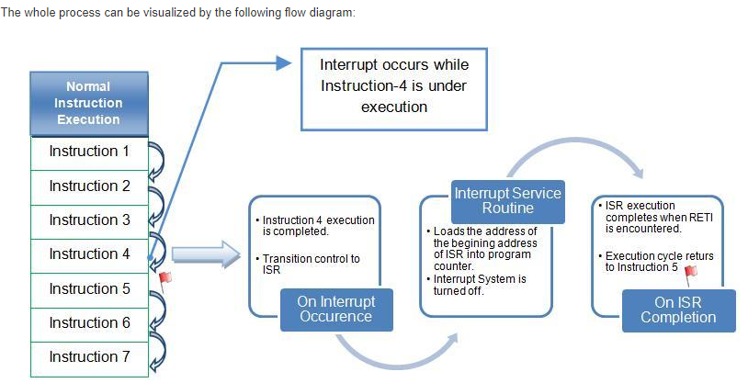
what happens when an interrupt occurs?
When an interrupt occurs, the normal flow of instructions is suspended by the microcontroller and the code corresponding to the interrupt, which has occurred, is executed. Once the code corresponding to the interrupt is executed completely the execution again begins from the same instruction where it was stopped.
Following is what happens when an interrupt occurs:
Microcontroller normally completes the instruction which is being executed.
The program control transfers to Interrupt Service Routine (ISR). Each interrupt have an associated ISR which is a piece of code which tells the microcontroller what to do when an interrupt has occurred.
Execution of ISR is performed by loading the beginning address of the corresponding ISR into program counter.
Execution of ISR continues until the return from the interrupt instruction (RETI) is encountered.
When ISR is complete, the microcontroller resumes processing where it left off before the interrupt occurred, i.e., program control is reverted back to the main program.

Slide 4
Why Should use Interrupt?
We can set up the processor so that it is looking for a specific external event (like a pin going low, or a timer overflowing) to become true, while it goes on and performs other tasks. When these events occur, we stop the current task, handle the event, and resume back where we left off. This gives us a great deal of flexibility; rather than having to actively poll our events to see if they have happened, we can instead just ignore them completely and trust our interrupt routines to process them instead.

Slide 5

Types Of Interrupt
There are two main sources of interrupts:
Hardware Interrupts, which occur in response to a changing external event such as a pin going low, or a timer reaching a preset value
Software Interrupts, which occur in response to a command issued in software
The 8-bit AVRs lack software interrupts, which are usually used for special operating system tasks like switching between user and kernel space, or for handling exceptions. Because of this, we'll only be looking at hardware interrupts.
Each AVR model contains a different set of interrupt sources.

Slide 6
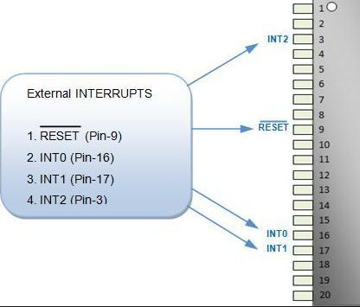
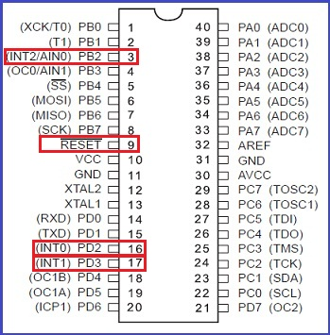
Interrupt Pinout

Slide 7
Steps
Programming Steps:
For programming an interrupt, the following steps must be followed:
1. Enable Global Interrupt: I bit in SREG register.
2. Set Interrupt Sense: MCUCR, MCUCSR
3. Enable Individual Interrupt: GICR.
4. Define the appropriate Interrupt service routine (ISR) for the interrupt.

Slide 8
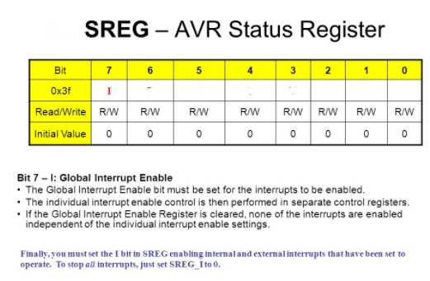
Step-1
Programming Steps:
1. Enable Global Interrupt: I bit in SREG register.
2. Set Interrupt Sense: MCUCR, MCUCSR
3. Enable Individual Interrupt: GICR.
4. Define the appropriate Interrupt service routine (ISR) for the interrupt.
Code:
SREG|=(1<<I);

Slide 9
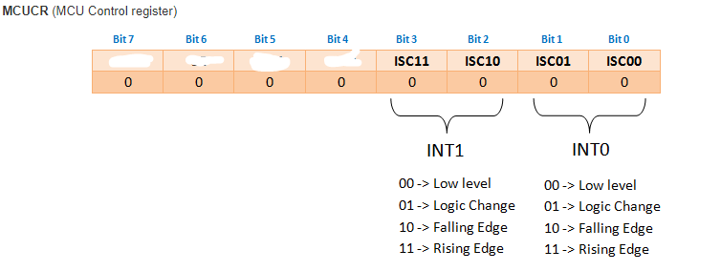
Step-2 ( if INT0, INT1 used )
Programming Steps:
1. Enable Global Interrupt: I bit in SREG register.
2. Set Interrupt Sense: MCUCR, MCUCSR
3. Enable Individual Interrupt: GICR.
4. Define the appropriate Interrupt service routine (ISR) for the interrupt.
Code:
MCUCR|=(1<<ISC01)|(1<<ISC00); // INT0 Rising edge

Slide 10
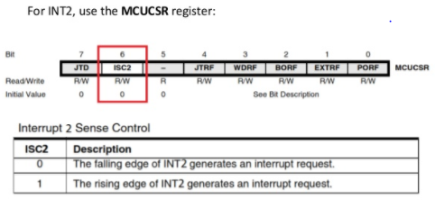
Step-2 ( if INT2 used )
Programming Steps:
1. Enable Global Interrupt: I bit in SREG register.
2. Set Interrupt Sense: MCUCR, MCUCSR
3. Enable Individual Interrupt: GICR.
4. Define the appropriate Interrupt service routine (ISR) for the interrupt.
Code:
MCUCSR|=(1<<ISC2); // INT2 Rising edge

Slide 11
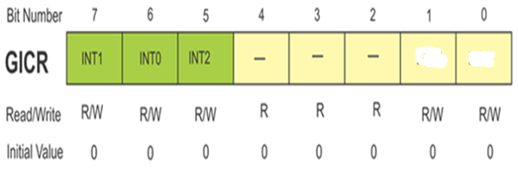
Step-3
Programming Steps:
1. Enable Global Interrupt: I bit in SREG register.
2. Set Interrupt Sense: MCUCR, MCUCSR
3. Enable Individual Interrupt: GICR.
4. Define the appropriate Interrupt service routine (ISR) for
the interrupt.
Code:
GICR|=(1<<INT0); // enable INT0

Slide 12
Step-4
Programming Steps:
1. Enable Global Interrupt: I bit in SREG register.
2. Set Interrupt Sense: MCUCR, MCUCSR
3. Enable Individual Interrupt: GICR.
4. Define the appropriate Interrupt service routine (ISR) for
the interrupt.
Code:
ISR(INT0_vect)
{
//write code here
}

Slide 13
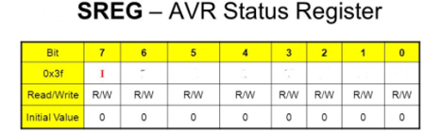
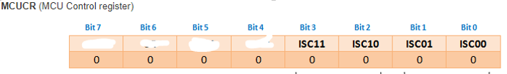

Interrupt Configuration: Summary
Programming:
#include<avr/interrupt.h>
int main()
{
init_int0();
while(1)
{
}
}
void init_int0(void)
{
//1.enable global interrupt : SREG
//2.set interrupt sense : MCUCR/MCUCSR
//3.enable individual interrupt :GICR
}
ISR(INT0_vect)
{
// write your instructions
}

Slide 14
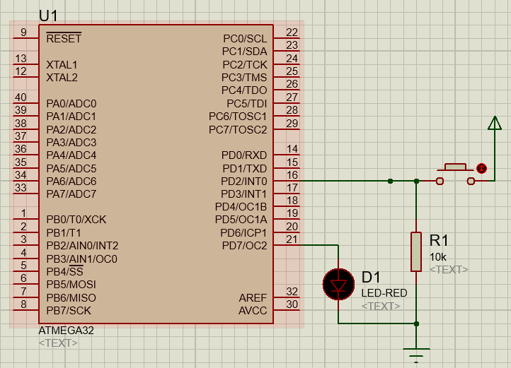
ADC

